Slide 1
Database Management Systems (DBMS)

Slide 2
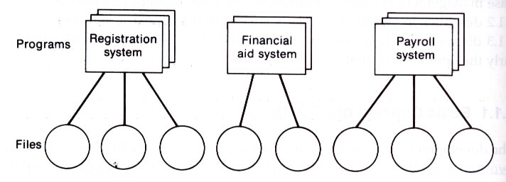
File Processing Systems
Two major problems with conventional file-processing systems:
  Data redundancy
    Duplicate storage required
    Multiple updating effort
    Possibility of inconsistent data
  Data dependence
File Processing Systems
Course
Name
Scholarship
Name
Name

Slide 3
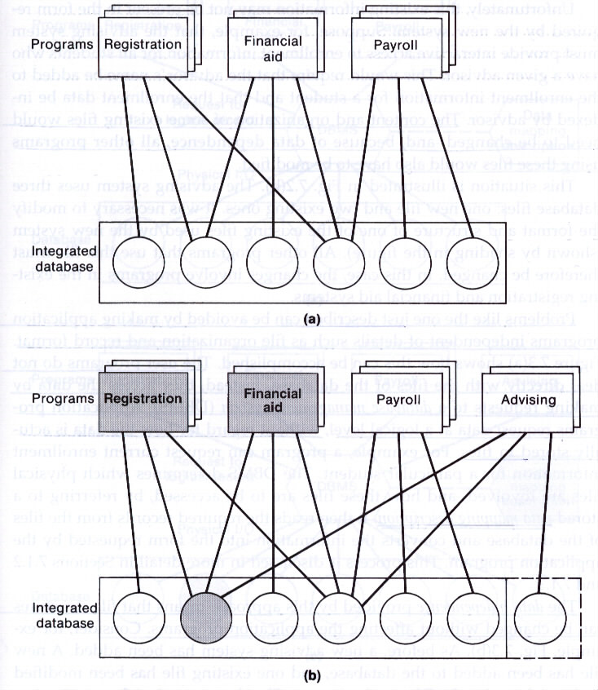
Data-Dependent Programs using an Integrated Database
Data redundancy is eliminated by using an integrated database.
Application programs that deal directly with physical files are data dependent.

Slide 4
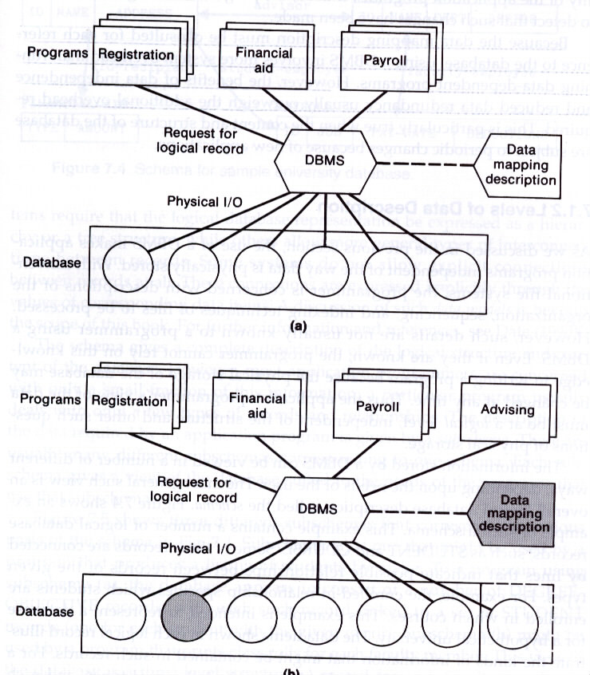
Data-Dependent Programs using a DBMS
Application programs access data, at a logical level, by making requests to a DBMS.
DBMS determines the physical files involved and how these files are to be accessed by referring to a stored data mapping description.
DBMS then reads the required records from the files and converts the information into the specified form.
The data independence means that file structures can be changed without affecting the application programs.

Slide 5
Data Independence
Advantages of data independence provided by a DBMS:
  Techniques used for physical storage of the database can be changed whenever desirable:
    Database can be moved to a different storage device
    Files can be reorganized, sorted in different sequences, or indexed by a different set of keys
Overhead:
  Because the data mapping description must be consulted for each reference to the database, using a DBMS involves more system overhead than using directly file-processing systems.
The benefits of data independence usually outweigh the additional overhead required.

Slide 6
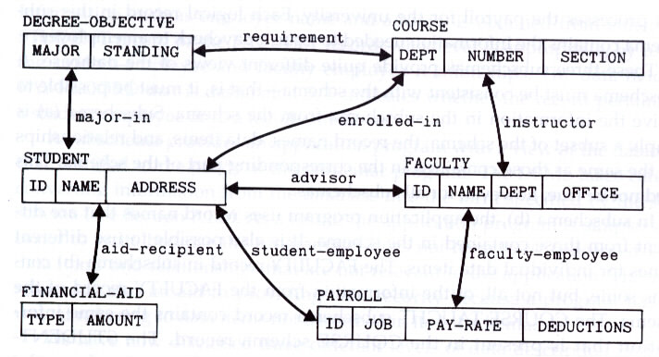
Schema
Schema: overall logical database description
  Logical database records
  Connected lines that indicate possible relationships between records

Slide 7
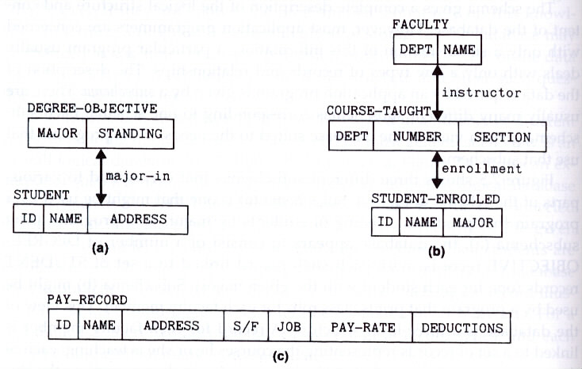
Subschema
Subschema: a small fraction of schema that are the description of the data required by an application program

Slide 8
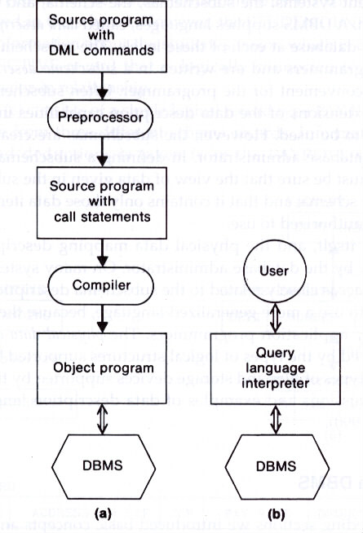
Interaction with a DBMS
Two principal methods for user interaction with a DBMS:
  Using a general-purpose programming language with a data manipulation language (DML)
  A special query language interpreter

Slide 9
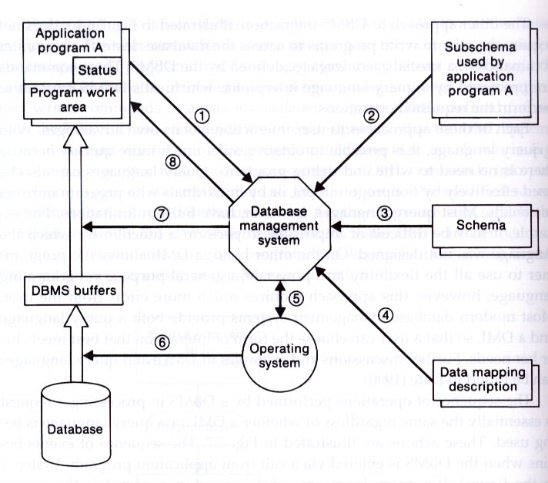
Typical Sequence of DBMS Actions
Three levels of data description

Slide 10
Text Editors

Slide 11
Document Editing
Four tasks in the document-editing process:
  Select the part of the target document to be viewed and manipulated
  Determine how to format this view on-line and how to display it
  Specify and execute operations that modify the target document
  Update the view appropriately

Slide 12
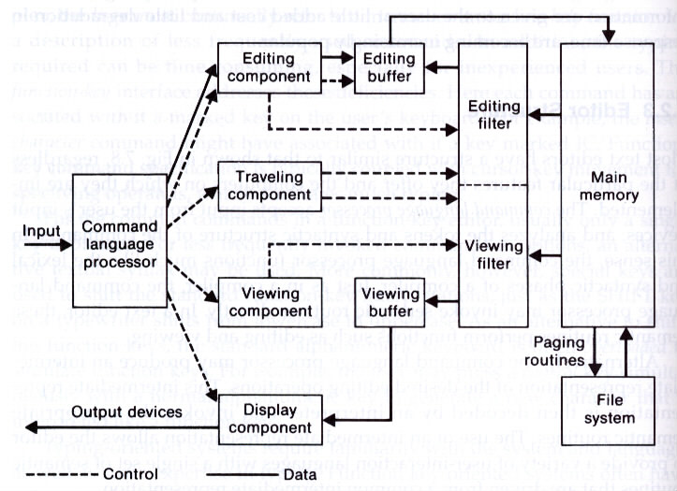
Typical Editor Structure
Text
Button
locator

